Slide 1
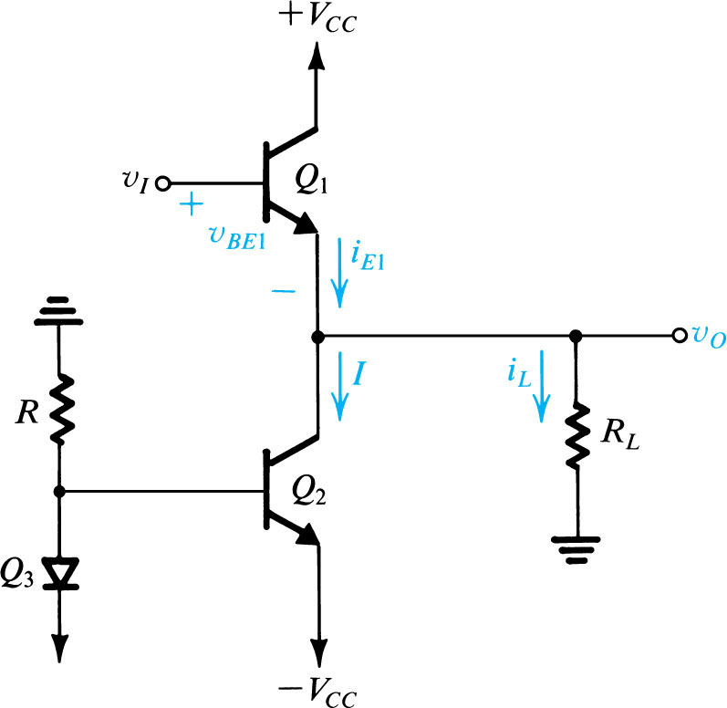
Quiz 6
Deadline: May 22, 2020
V_{CC} = 12V
A transistor circuit is shown as in the Figure.
Plot DC and AC load lines on the same graph i_{C} – v_{CE} (provide sufficiently values of voltages and currents)
What is the swing of the of the sinusoid at the output v_{o}.
Hint:
I_{CQ} = 1 mA
R_{C} = 6K
v_{o}
C→ ∞
R_{L} = 6K
i_{C}
AC load -line
Q point
DC load -line
v_{CE}
2. A class A power amplifier is shown in the Figure. Assume that V_{CC} = 12V, and R_{L} = 500Ω. All transistors are identical with V_{BE} = 0.7V and V_{CEsat} = 0.2V.
Compute current I. If I₁ = I, compute R.
Compute maximum power delivered to R_{L}.
What are max and min voltages of v_{I}. Give values i_{E1} corresponding to v_{Imax} and v_{Imin}.
Is there any limitation for low frequency? Why?
I₁

